Slide 1
Adventure Time SA
Website & Mobile Application UX/UI Presentation

Slide 2
MISSION & GOALS
Outdoor Adventure Promotion
Promoting outdoor activities, eco-tourism and exciting experiences across the Western Cape.
Customer Experience
Providing families, tourist, schools and corporate groups with convenient and memorable adventure experiences.
Digital Platform Development
Developing a user-friendly website and mobile application for exploring activities, requesting quotations and making bookings

Slide 3
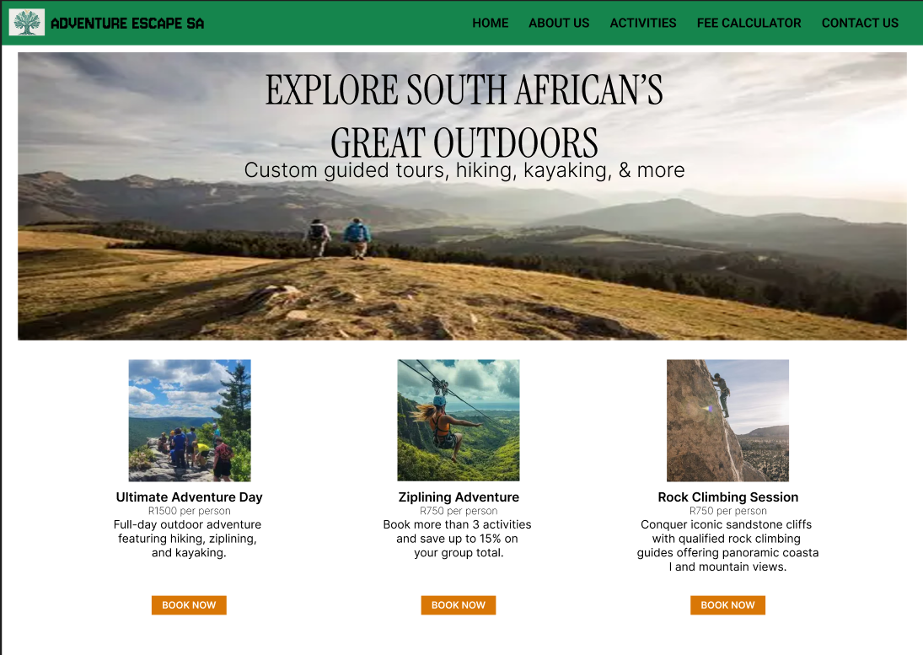
Desktop UI Wireframes
Hero Overlay Headline
Clean serif typography centered directly over high-impact imagery.
Horizontal Package Cards
Equal-width flexbox cards offering side-by-side activity views.

Slide 4
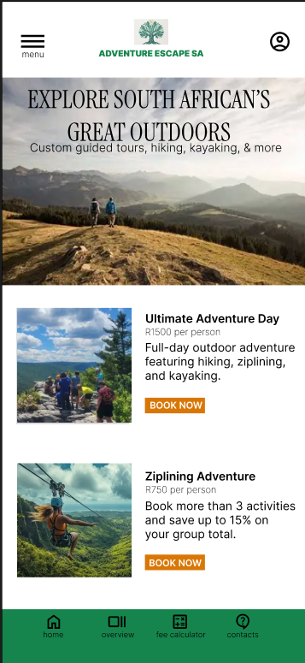
Mobile UI Prototype
Vertical Single-Column Stacking
Automatic reflow for single-hand mobile operation.
Instant Mobile Quote Request
Tap-to-save quote options designed for mobile users.
Touch-Optimized Callouts
Large target areas for easy navigation on screen.

Slide 5
Core Development Architecture
HTML5 & Structure
Semantic markup across root and nested subpage folders.
CSS Flexbox Layouts
Custom stylesheet supporting responsive side-by-side views.
JavaScript & Git Versioning
Interactivity scripts linked site-wide and committed to GitHub

Slide 6
THANK YOU!!!

